Slide 1
Relational Model (Part-3 of 3)

Slide 2
Example of Relations
Banking Example
branch (branch_name, branch_city, assets)
customer (customer_name, customer_street, customer_city)
account (account_number, branch_name, balance)
loan (loan_number, branch_name, amount)
depositor (customer_name, account_number)
borrower (customer_name, loan_number)

Slide 3
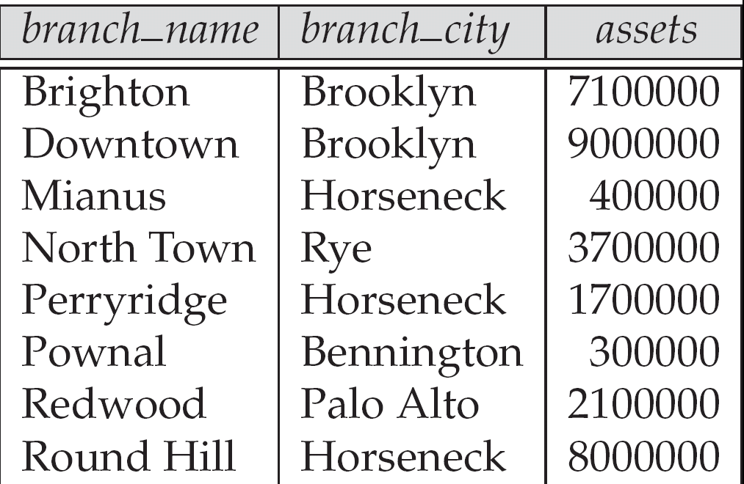
1. The branch relation

Slide 4

2. customer Relation

Slide 5

3. Account Relation

Slide 6

4. The loan relation

Slide 7

5. The depositor Relation

Slide 8
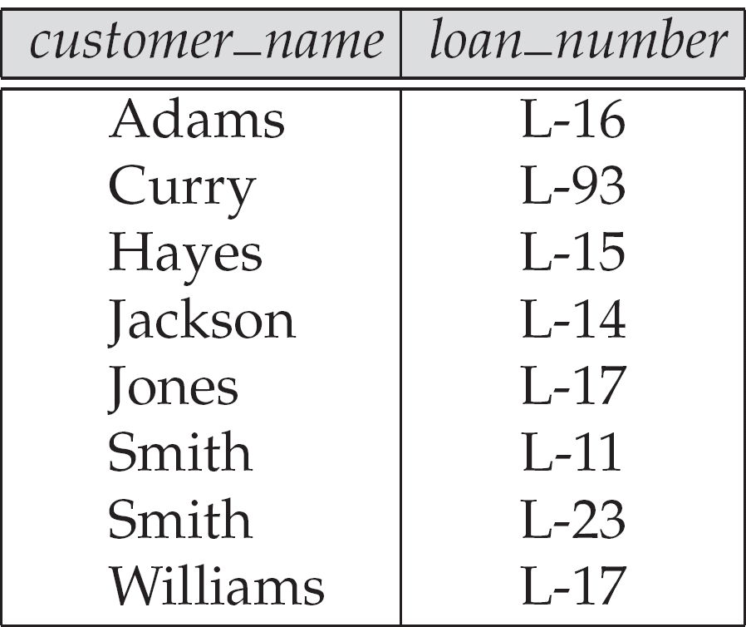
6. The borrower relation

Slide 9
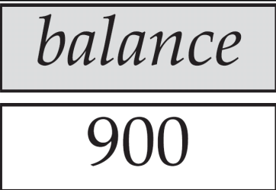
Example Queries
Find the largest account balance
  Strategy:
    Find those balances that are not the largest
      Rename account relation as d so that we can compare each account balance with all others
    Use set difference to find those account balances that were not found in the earlier step.
  The query is:
∏_{balance}(account) - ∏_{account.balance}
(σ_{account.balance < d.balance} (account x ρ_{d} (account)))

Slide 10
Bank Example Queries
Find the names of all customers who have a loan and an account at bank.
  ∏_{customer_name} (borrower) ∩ ∏_{customer_name} (depositor)
Find the name of all customers who have a loan at the bank and the loan amount, loan_number.
  ∏customer_name, loan_number, amount (borrower loan)

Slide 11



Bank Example Queries
Find all customers who have an account from at least the “Downtown” and the Uptown” branches.
    ∏_{customer_name} (σ_{branch_name = “Downtown”} (depositor account )) ∩
    ∏_{customer_name} (σ_{branch_name = “Uptown”} (depositor account))

Slide 12

Generalized Projection
Extends the projection operation by allowing arithmetic
functions to be used in the projection list.
E is any relational-algebra expression
Each of F₁, F₂, …, F_{n} are are arithmetic expressions
involving constants and attributes in the schema of E.
Given relation:
credit_info(customer_name, limit, credit_balance),
Find how much more each person can spend:
∏customer_name, limit – credit_balance (credit_info)

Slide 13
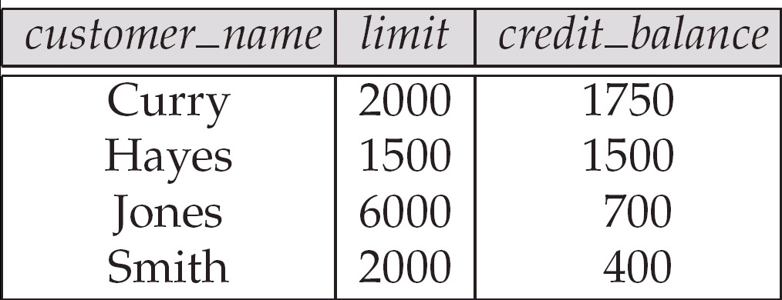
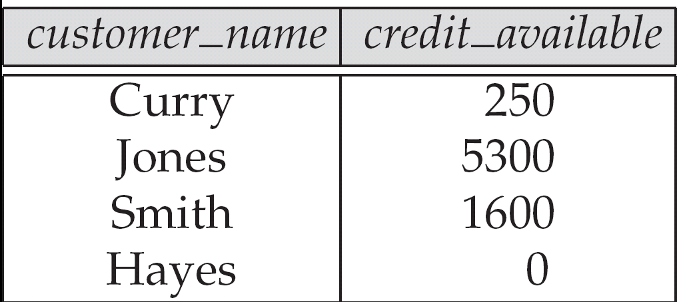
The credit_info relation

Slide 14



Aggregate Operation – Example
Relation account grouped by branch-name:
branch_name
account_number
balance
Perryridge
Perryridge
Brighton
Brighton
Redwood
A-102
A-201
A-217
A-215
A-222
400
900
750
750
700
_{branch_name} g _{sum(balance)} (account)
branch_name
sum(balance)
Perryridge
Brighton
Redwood
1300
1500
700

Slide 15
Aggregate Functions (Cont.)
Result of aggregation does not have a name
  Can use rename operation to give it a name
  For convenience, we permit renaming as part of aggregate operation
_{branch_name} g _{sum(balance) as sum_balance} (account)

Slide 16
Outer Join – Example
Relation loan
loan_number
branch_name
amount
L-170
L-230
L-260
Downtown
Redwood
Perryridge
3000
4000
1700
Relation borrower
customer_name
loan_number
Jones
Smith
Hayes
L-170
L-230
L-155

Slide 17
Outer Join – Example
Join
loan borrower
loan_number
branch_name
amount
customer_name
L-170
L-230
Downtown
Redwood
3000
4000
Jones
Smith
Left Outer Join
loan borrower
loan_number
branch_name
amount
customer_name
L-170
L-230
L-260
Downtown
Redwood
Perryridge
3000
4000
1700
Jones
Smith
null

Slide 18
Outer Join – Example
Right Outer Join
loan borrower
loan_number
branch_name
amount
customer_name
L-170
L-230
L-155
Downtown
Redwood
null
3000
4000
null
Jones
Smith
Hayes
Full Outer Join
loan borrower
loan_number
branch_name
amount
customer_name
L-170
L-230
L-260
L-155
Downtown
Redwood
Perryridge
null
3000
4000
1700
null
Jones
Smith
null
Hayes

Slide 19
Deletion Examples
Delete all account records in the Perryridge branch.
account ← account – σ _{branch_name = “Perryridge”} (account )
Delete all loan records with amount in the range of 0 to 50
loan ← loan – σ _{amount ≥ 0 and amount ≤ 50} (loan)
Delete all accounts at branches located in Needham.
r₁ ← σ _{branch_city = “Needham”} (account branch )
r₂ ← ∏ _{account_number,} _{branch_name, balance} (r₁)
r₃ ← ∏ _{customer_name, account_number} (r₂ depositor)
account ← account – r₂
depositor ← depositor – r₃

Slide 20
Insertion Examples
Insert information in the database specifying that Smith has $1200 in account A-973 at the Perryridge branch.
account ← account ∪ {(“A-973”, “Perryridge”, 1200)}
depositor ← depositor ∪ {(“Smith”, “A-973”)}
Provide as a gift for all loan customers in the Perryridge
branch, a $200 savings account. Let the loan number serve
as the account number for the new savings account.
r₁ ← (σ_{branch_name = “Perryridge”} (borrower loan))
account ← account ∪ ∏_{loan_number, branch_name, 200} (r₁)
depositor ← depositor ∪ ∏_{customer_name, loan_number} (r₁)

Slide 21
Update Examples
Make interest payments by increasing all balances by 5 percent.
account ← ∏ account_number, branch_name, balance * 1.05 (account)
Pay all accounts with balances over $10,000 6 percent interest
and pay all others 5 percent
account ← ∏ account_number, branch_name, balance * 1.06 (σ _{BAL > 10000} (account ))
∪ ∏ account_number, branch_name, balance * 1.05 (σ_{BAL ≤ 10000} (account))

Slide 22
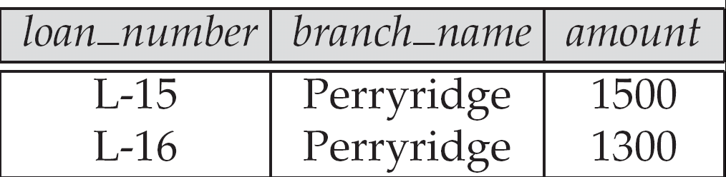
Example
Select all rows having branch Perryridge
Result of σ_{branch_name = “Perryridge”} (loan)

Slide 23
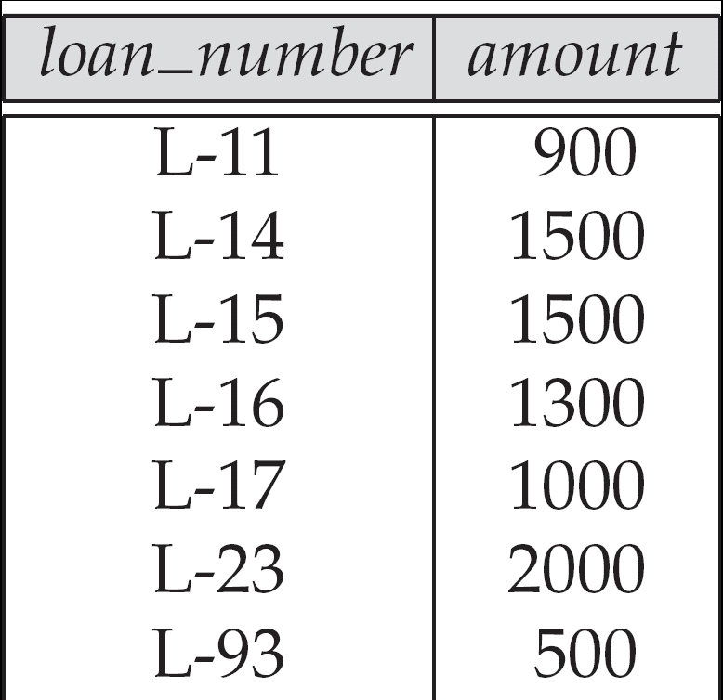
Example
Find Loan number and the amount of the loan

Slide 24

Example:
To eliminate the branch_name attribute of account
∏_{account_number, balance} (account)

Slide 25
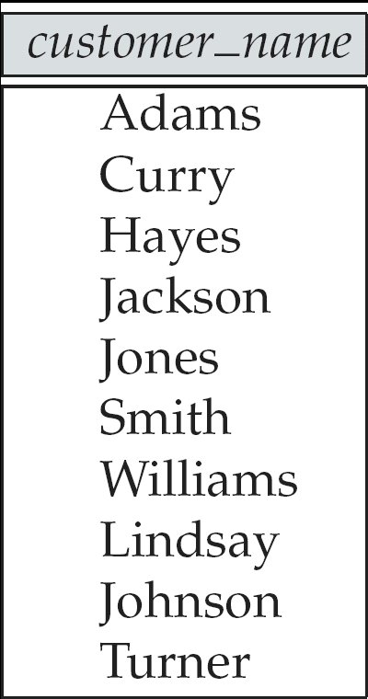
Example:
Find all customers with either an account or a loan.
∏_{customer_name} (depositor) ∪ ∏_{customer_name} (borrower)

Slide 26
Bank Example Queries
Find all customers who have an account from at least the “Downtown” and the Uptown” branches.
  Query 1
    ∏_{customer_name} (σ_{branch_name = “Downtown”} (depositor account )) ∩
    ∏_{customer_name} (σ_{branch_name = “Uptown”} (depositor account))
  Query 2
  ∏_{customer_name, branch_name} (depositor account)
  ÷ ρ_{temp(branch_name)} ({(“Downtown” ), (“Uptown” )})
  Note that Query 2 uses a constant relation.

Slide 27
Bank Example Queries
Find all customers who have an account at all branches located in Brooklyn city.
∏_{customer_name, branch_name} (depositor account)
÷ ∏_{branch_name} (σ_{branch_city = “Brooklyn”} (branch))

Slide 28
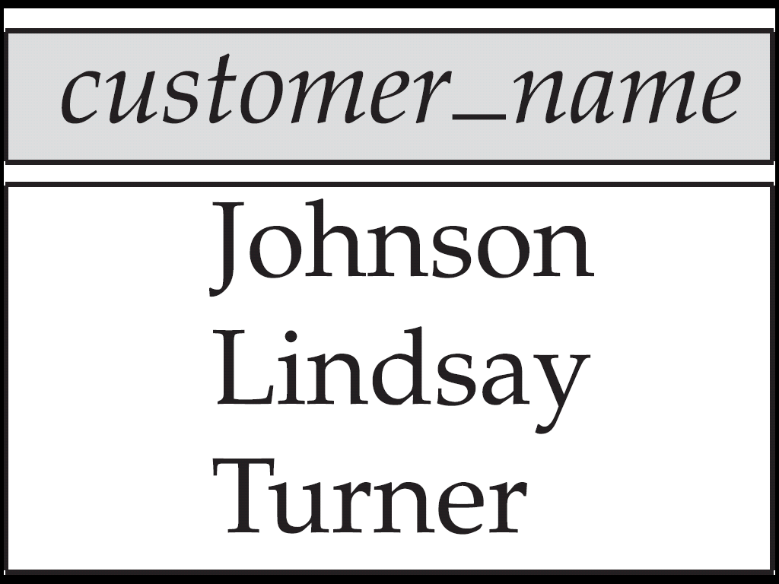
Figure 2.12:
Customers with an account but no loan

Slide 29
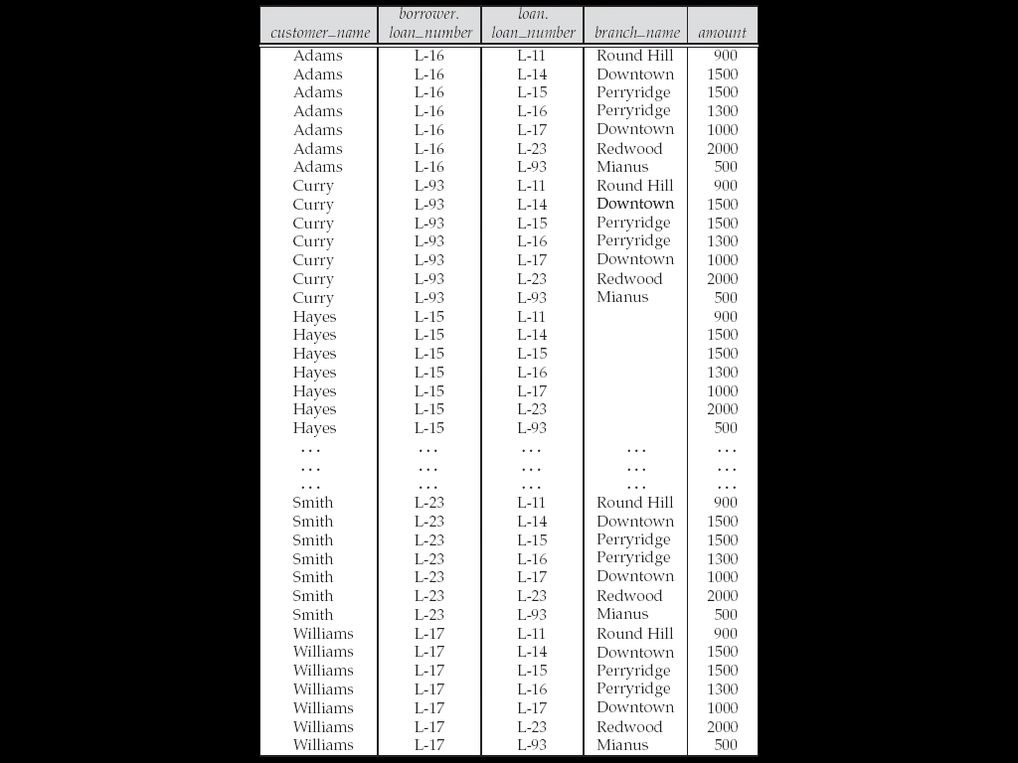
Result of borrower |X| loan

Slide 30
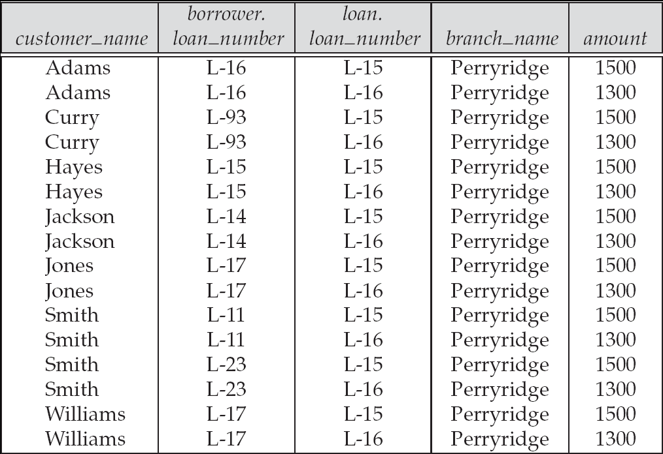

Slide 31
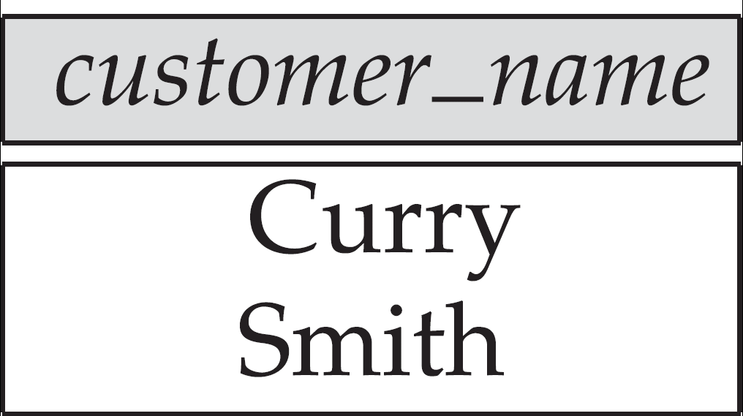
Customers who live on the same street and in the same city as Smith

Slide 32
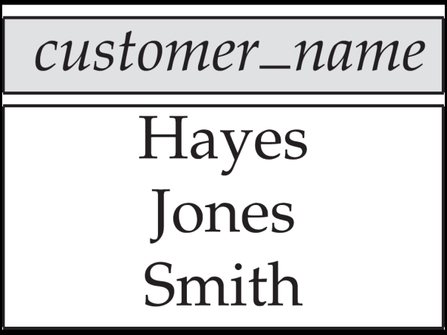
Customers with both an account and a loan at the bank

Slide 33
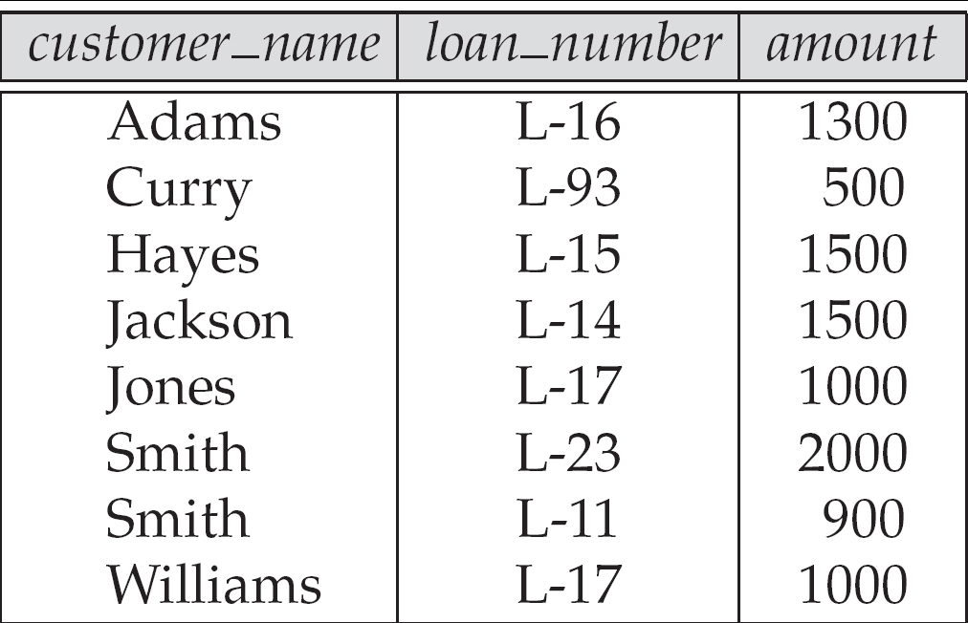
Figure 2.20

Slide 34
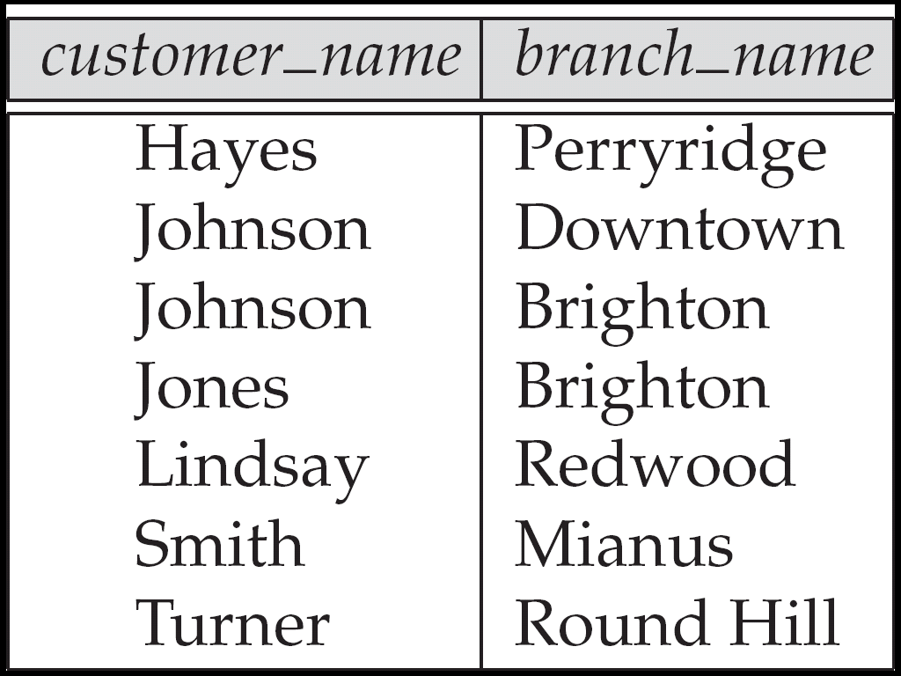
Figure 2.23

Slide 35
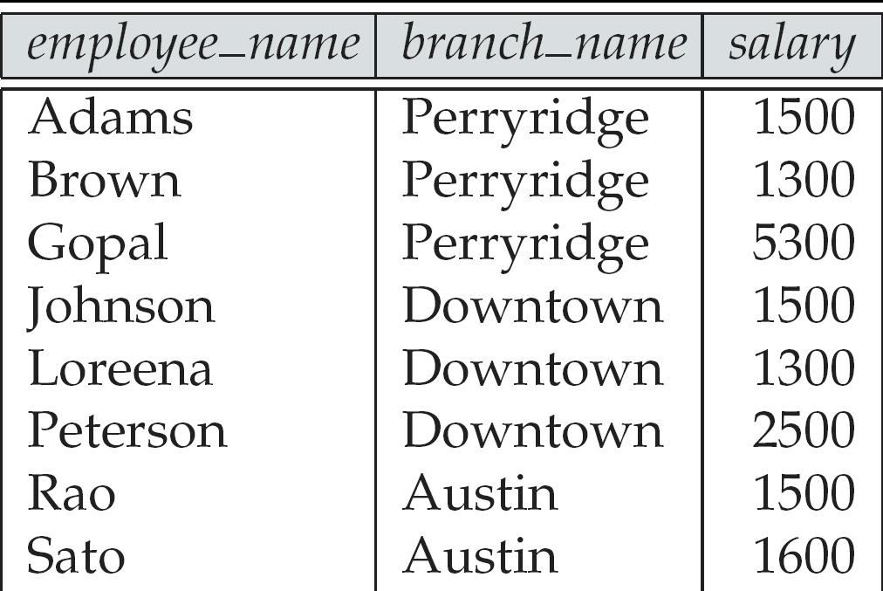
Figure 2.26: The pt_works relation

Slide 36
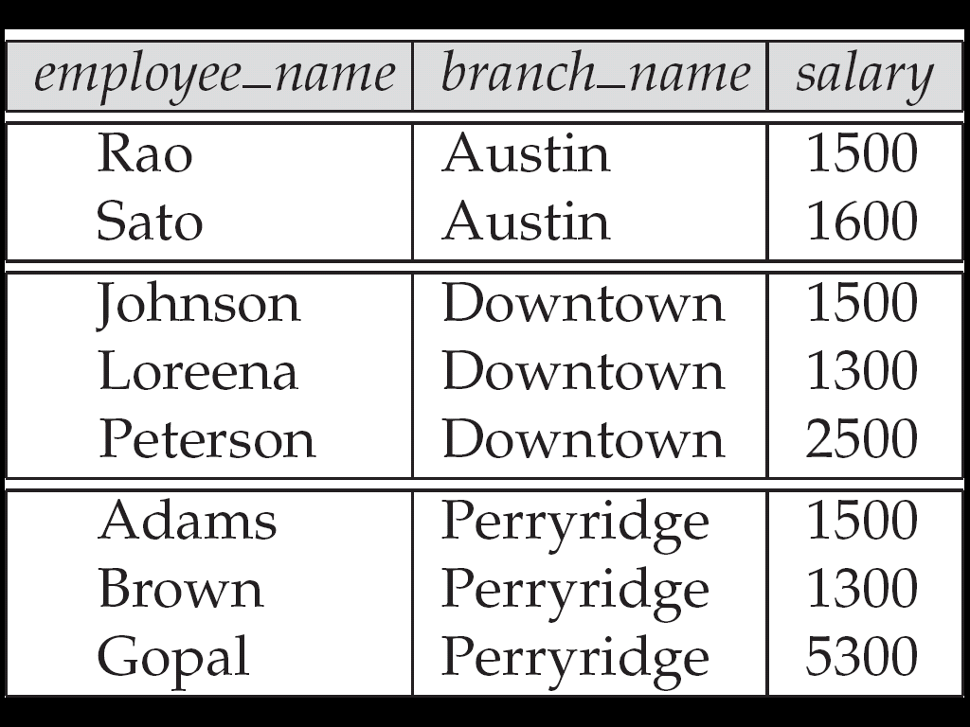
Figure 2.27
The pt_works relation after regrouping

Slide 37
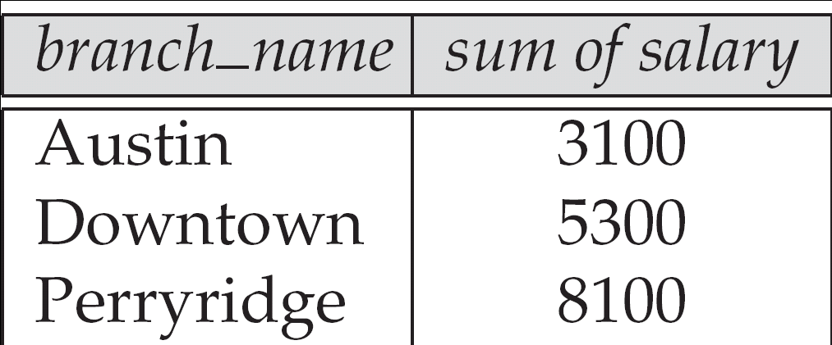
Figure 2.28

Slide 38
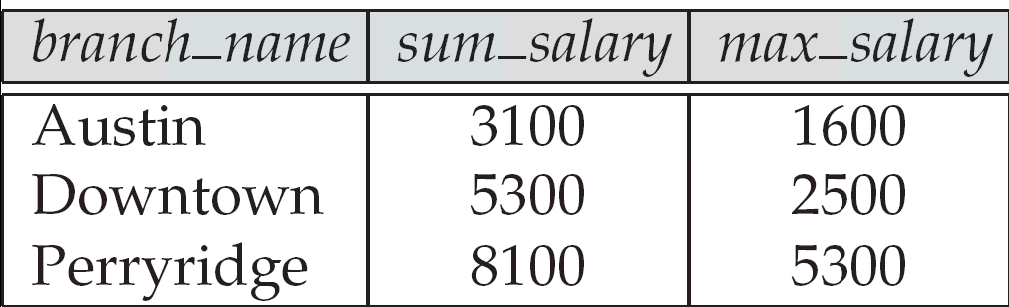
Figure 2.29

Slide 39
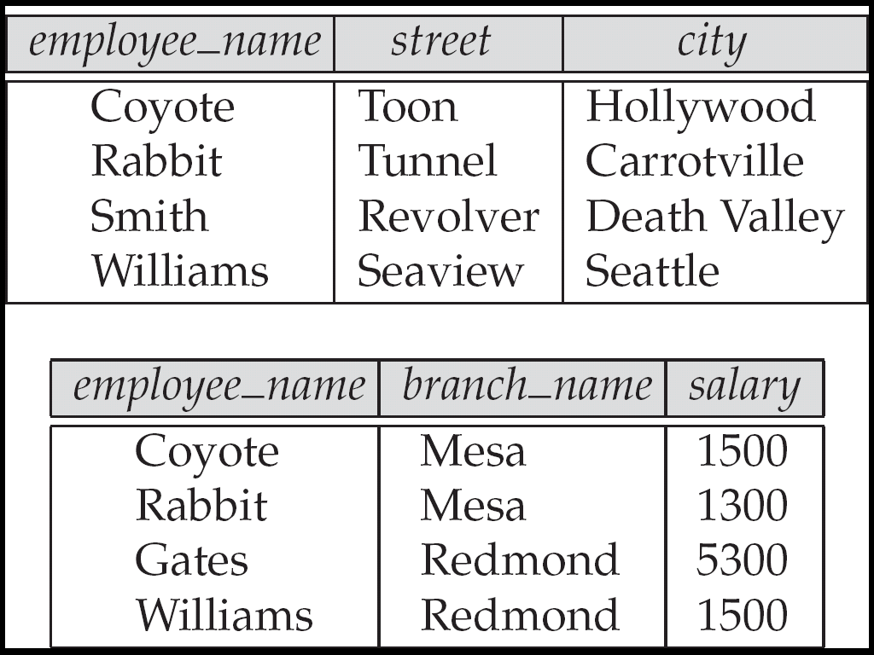
Figure 2.30
The employee and ft_works relations

Slide 40
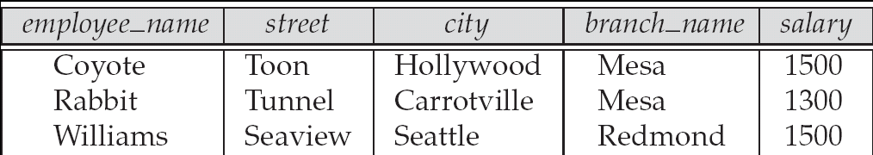
Figure 2.31

Slide 41
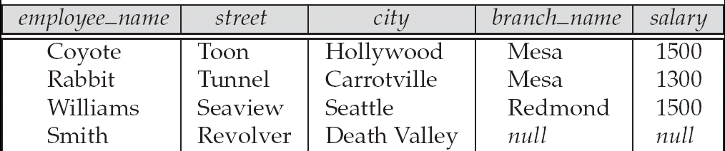
Figure 2.32

Slide 42
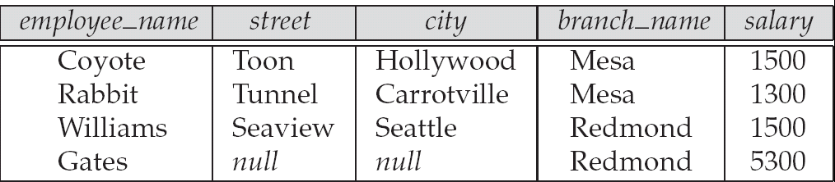
Figure 2.33

Slide 43
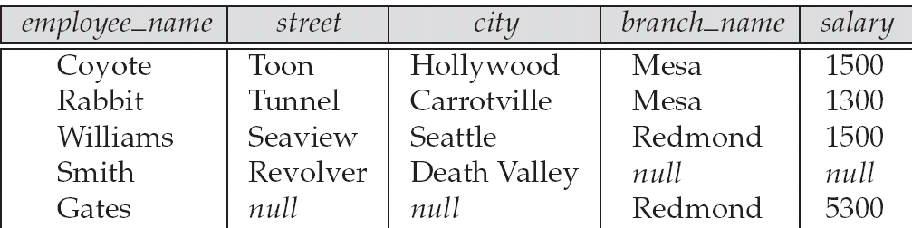
Figure 2.34

Slide 44
Reference
System Concepts
Abraham Silberschatz, Henry F. Korth, S. Sudarshan
Tata McGraw-Hill

